Slide 1

BRYSON ISD
2022-2023
Proposed Budget
Prepared by
Greg London
Bryson ISD Superintendent

Slide 2
Property Values
M&O certified property values comparison.
  19-20 $ 167,710,988
  20-21 $ 153,218,048
  21-22 $ 193,703,321
  22-23 $ 197,685,097
I&S certified property values comparison.
  19-20 $ 235,074,048
  20-21 $ 219,686,050
  21-22 $ 193,703,321
  22-23 $ 197,685,097

Slide 3
Factors Affecting Finances
Wind Farms are now taxed the same for the M&O rate and I&S rate.
Senate Wind Ch. 313 agreement benefits the school district have ended.
District enrollment is 258 (Budget was built on RADA of 234)
State will fund us on current year values.
Interest on fund balance money was at .151% in July and .2% in August.
Notes:
Hold harmless for last years MTN

Slide 4
Goals of Budget Process
Provide High Quality School for Children of the Community.
Fairness and Responsibility to Taxpayers
Maximize Available State Aid
Ensure Future Financial Health of District
Retain High Quality personnel
Work toward a balanced budget

Slide 5
Property Taxes are Determined By:
Local Property Values
State Laws – M&O tax rate compression this biennium due to the passage of HB3 is .96340 (2021-2022 rate was .96640)
District Tax Rate – Effort (we have highest M&O rate possible without a Tax Ratification Election)
Bonded Debt; I&S tax rate is .44
Total tax rate is 1.38410

Slide 6
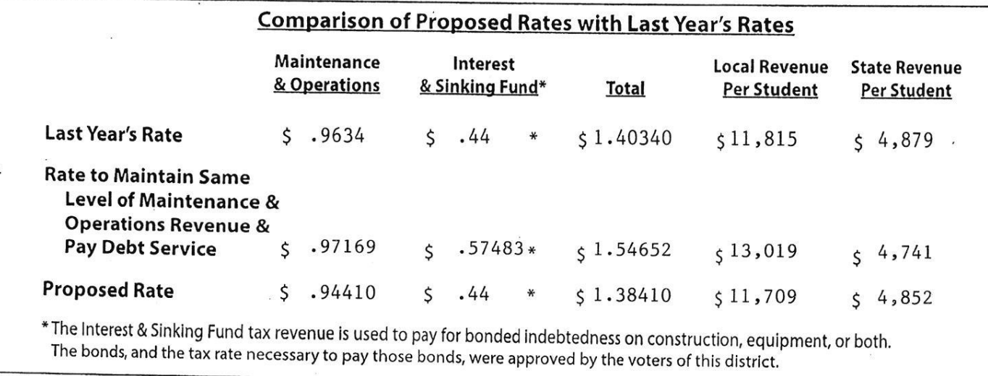
Notes:
Rounding

Slide 7
Fund 199

Slide 8
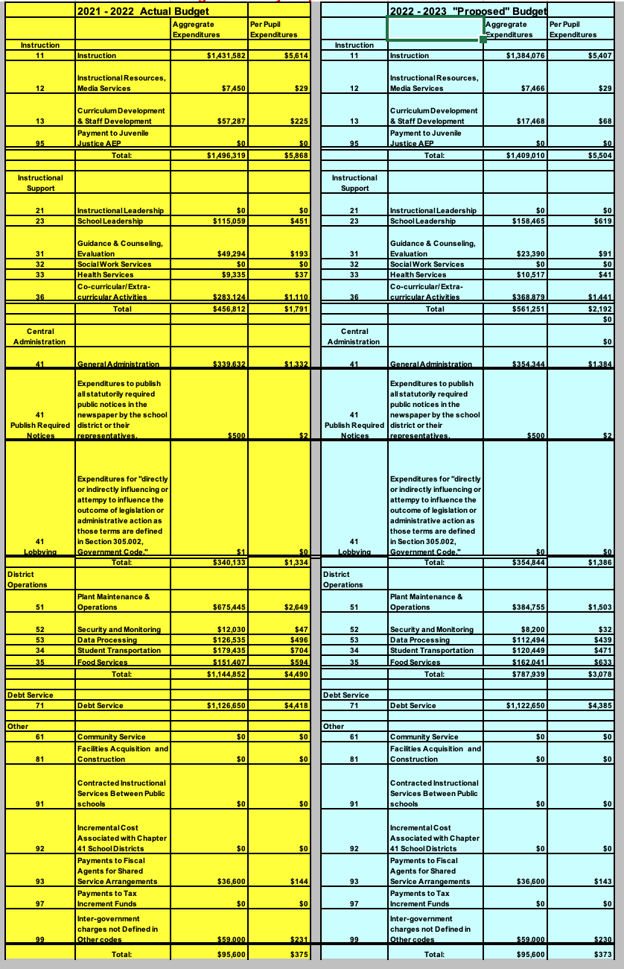

Slide 9
Fund 240

Slide 10
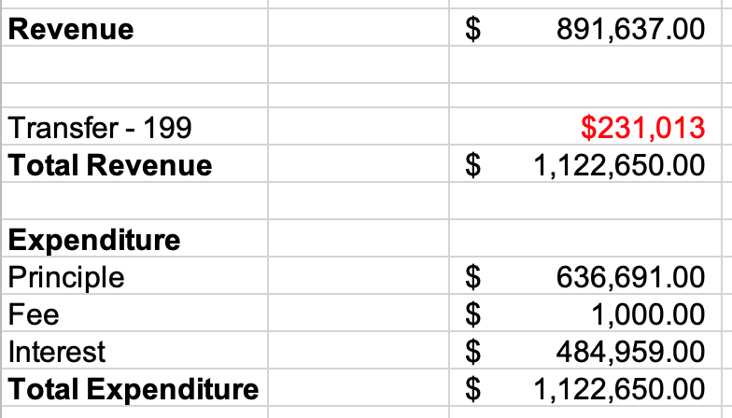
Fund 599

